Slide 1
Object Oriented and Programming
Lab 3
METHODS (Java)

Slide 2
Objectives
Methods in Java
Parameter passing and return statements
Method invocations

Slide 3

Methods
Java method is a collection of statements that are grouped together to perform an operation.
When you call the System.out.println method, for example, the system actually executes several statements in order to display a message on the console.
In general, a method has the following syntax:

Slide 4
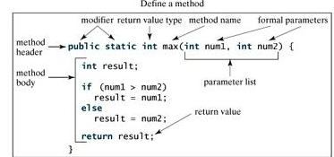
Methods Parts

Slide 5
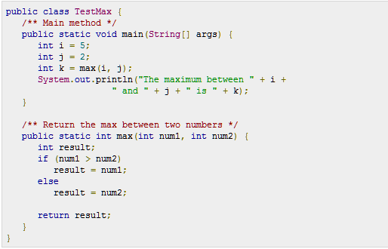
Task1

Slide 6
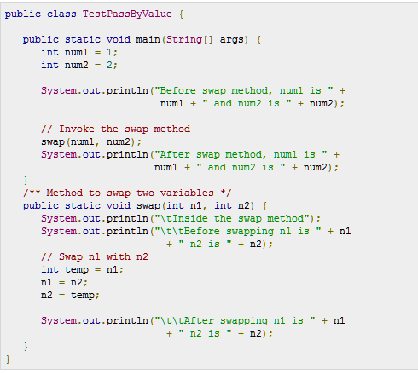
Task 2

Slide 7
Lab Tasks
Create a function that when given an integer value returns the square of the function. Write the code and show the output here. Show the trace call on the code using a pencil.
Write a function that accepts two strings and returns the longer of both. Display the longer string. Write the code and show the output here. Show the trace call on the code using a pencil.
Write a function that receives an array and displays the contents of the array. Write the code and show the output here. Show the trace call on the code using a pencil.

Slide 8
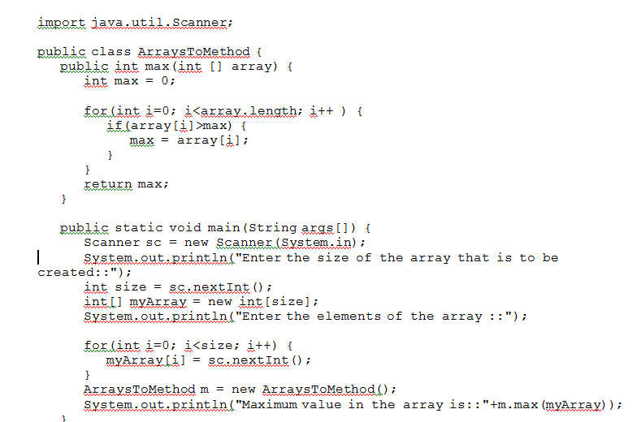
Arrays using Method

Slide 9
